Slide 1
CELLO INVESTMENT PROCESS: Long/Short equity
July 2015

Slide 2
Investment Style
The investment style provides an indication of how portfolio managers reach their investment decisions and how long they intend to hold their positions. In addition, it provides insight into the portfolio construction process and the manager’s investment strategy.
The CRE Long/Short Equity Strategy is strongly Investor-style oriented and consequently relies heavily on fundamental techniques of equity valuation. These include monitoring trends in cash flow, implied Cap rates, balance sheet and income statement analysis etc. From time to time, technical factors such as earnings or return momentum are also taken into account.
Style Factors | CRE Long/Short Strategy
Trader vs Investor | Investor-oriented with heavy reliance on fundamental bottoms-up analysis of company financials. Technical factors such as earnings or return momentum also taken into account.
Holding Period | Longs are more value-oriented: ~6-9 months Shorts are more tactical: ~3 months
Investment Signals | Thematic views from the CRE market are considered in conjunction with valuation screens for a universe of ~100-125 CRE-linked equities in order to identify potential long/short targets. An investment thesis is built for each potential target through consideration of Discounts, Catalysts, and Market inefficiencies, among other factors.
Source: Blackrock, Cello

Slide 3
Portfolio Construction
The portfolio construction process for a portfolio manager establishes a baseline for understanding the underlying investment philosophy, evaluating portfolio changes, and establishing performance expectations.
Three key components of position sizing include:
Position initiation: How initial position sizes are established
Position Management: What factors influence changes in position size
Sell Discipline: The process for closing out a long or short position
Position Initiation
Price targets are set for Bull/Base/Bear scenarios are sizing depends on where pricing is relative to targets. Positions are typically established at a “toe-hold” or “mid-size” level with no distinction between the long and short side. Other factors influencing sizing include timing, portfolio attributes, and upside relative to other positions in the portfolio.
Position Management
Position sizes are actively rebalanced as stocks move towards or away from price targets. Generally, winners are trimmed and losers are added to. Scaling is also a function of risk/reward assessment as conviction levels move higher or the investment thesis begins to bear fruit. On the short side, scaling also depends on availability. Catalysts paly a significant role in terms of the investment strategy and are captured through scenario analysis (Bull/Base/Bear). Each scenario embeds a specific event that leads to the stock converging to its price target.
Sell Discipline
Exit methodologies include reaching price targets, the availability of better opportunities, a discrediting of the investment thesis (when the movements of the position are not in line with the thesis), the failure of a catalyst to materialize, and the appearance of systemic risk factors.

Slide 4
Investment Style
The investment style provides an indication of how portfolio managers reach their investment decisions and how long they intend to hold their positions. In addition, it provides insight into the portfolio construction process and the manager’s investment strategy.
The CRE Long/Short Equity Strategy is strongly Investor-style oriented and consequently relies heavily on fundamental techniques of equity valuation. These include monitoring trends in cash flow, implied Cap rates, balance sheet and income statement analysis etc. From time to time, technical factors such as earnings or return momentum are also taken into account.
Style Factors
CRE Long/Short Strategy
Trader vs Investor
Investor-oriented with heavy reliance on fundamental bottoms-up analysis of company financials. Technical factors such as earnings or return momentum also taken into account.
Holding Period
Longs are more value-oriented: ~6-9 months
Shorts are more tactical: ~3 months
Holding Period
Investment Signals
Thematic views from the CRE market are considered in conjunction with valuation screens for a universe of ~100-125 CRE-linked equities in order to identify potential long/short targets. An investment thesis is built for each potential target through consideration of Discounts, Catalysts, and Market inefficiencies, among other factors.
Investment Signals
Source: Blackrock, Cello

Slide 5
Portfolio Construction
The portfolio construction process for a portfolio manager establishes a baseline for understanding the underlying investment philosophy, evaluating portfolio changes, and establishing performance expectations.
Three key components of position sizing include:
Position initiation: How initial position sizes are established
Position Management: What factors influence changes in position size
Sell Discipline: The process for closing out a long or short position
Position Initiation
Price targets are set for Bull/Base/Bear scenarios are sizing depends on where pricing is relative to targets. Positions are typically established at a “toe-hold” or “mid-size” level with no distinction between the long and short side. Other factors influencing sizing include timing, portfolio attributes, and upside relative to other positions in the portfolio.
Position Management
Position sizes are actively rebalanced as stocks move towards or away from price targets. Generally, winners are trimmed and losers are added to. Scaling is also a function of risk/reward assessment as conviction levels move higher or the investment thesis begins to bear fruit. On the short side, scaling also depends on availability. Catalysts paly a significant role in terms of the investment strategy and are captured through scenario analysis (Bull/Base/Bear). Each scenario embeds a specific event that leads to the stock converging to its price target.
Sell Discipline
Exit methodologies include reaching price targets, the availability of better opportunities, a discrediting of the investment thesis (when the movements of the position are not in line with the thesis), the failure of a catalyst to materialize, and the appearance of systemic risk factors.

Slide 6
Short selling rationale
Shorting serves various different purposes for the CRE Long/Short Equity strategy.
1
Hedge Portfolio’s Market Exposure and/or Sector Exposure
Hedge market risk (beta risk)
Protect the portfolio’s long positions against a broad market decline
Reduce portfolio’s correlation to the markets
Reduce volatility of a portfolio’s returns with the market
Strategy may short ETFs (IYR) or buy/sell derivatives to hedge portfolio and sector risk.
2
Target Individual Overvalued Stocks
Profit from a decline in the stock price for company-specific reasons (overvaluation, weak management, declining revenue and earnings etc.)
Based on extensive fundamental research along with identification of catalysts that would lead to a stock price decline.
3
Capture Relative Value
Identify two similar companies whose stocks are currently trading at a price relationship outside a historical range.
Source: Blackrock, Cello

Slide 7
Short sALE EXAMPLE
The example illustrates some of the mechanics behind a typical short stock sale that anticipates a decline in the price of a particular stock.
Building a short case places a significant emphasis on top-down analysis and sectoral work corresponding to the underlying CRE market. In addition, it also relies on a combination of forensic accounting and catalyst identification.
Return Source | Cost Basis | Exit Proceeds | Return | Assumptions/Notes
Short Position: XYZ Co. | $2,000,000 | $1,500,000 | $500,000 | 200,000 shares shorted @$10 per share and covered @$7.50 per share
Short Rebate on Short Sale Proceeds |  |  | $30,000 | Rate of 1.5% earned on short proceeds of $2,000,000
Cost of Borrowing Shares |  |  | ($5,000) | Rate of 0.25% paid on initial stock loan, with a borrow value of $2 million
Dividend Payment on Short Position |  |  | ($20,000) | Dividend yield of 1% on XYZ Co.
Margin Costs (on Short Position) |  |  | ($15,000) | Rate of 2.5% paid on margin of $600,000*
Total Return Total Return (%) |  |  | $490,000 24.5% | $490,000 / $2,000,000 × 100 = 24.5%
Details | Amount
Portfolio’s Net Asset Value (NAV) | $100,000,000
Position Weighting of Portfolio | 2%
Initial Capital for the Trade | $2,000,000
Percent Return on the Trade | 24.5%
Percent Return Attribution | 0.49%
Details | Contribution | Portfolio Attribution
Short Position | 25% | 0.5%
Short Rebate | 1.5% | 0.03%
Cost of Borrowing Shares | -0.25% | -0.005%
Dividend Payment | -1% | -0.02%
Margin Costs | -0.75% | -0.015%
Total Return | 24.5% | 0.49%
* Short Cost = Margin of $600,000 @2.5%, which is calculated as follows:
($2,000,000) × 130% short margin + $2,000,000 = ($2,600,000) + $2,000,000 = ($600,000);
Net Margin used = ($600,000) in margin rate @2.5% . 130% short margin is based on the prime broker’s margin requirement.
Source: Blackrock, Cello

Slide 8
Strategy categorization: LOW BETA
The CRE Long/Short Equity strategy category is generally low beta both from a dollar value (dollars on the long side equal dollars on the short side) or beta adjusted (beta on the long side matches beta on the short side) basis.
The net market exposure is driven mostly by bottoms-up stock selection.
Risk controls are established on a top-down basis in order to manage gross and net market exposure and sector allocation.
Low Beta Strategy
With Highest Market Exposure
Max Market Exposure: 30%
Gross Invested: 110%
Low Beta Strategy
With Lowest Market Exposure
Min Market Exposure: 0%
Gross Invested: 120%
70%
Gross Long
60%
Gross Long
Max: 30%
Market Exposure
Min: 0%
Market Exposure
40%
Gross Short
60%
Gross Short

Slide 9
Risk Controls
Position concentration
The CRE Long/Short Equity Strategy will actively manage position, sector, and market exposure (both gross and net).
No more than 5% of NAV for any single position (either long or short)
Sector concentration
No more than 20% in any specific sector (Apartments, Hotels, REITs..)
Gross Exposure
No more than 100% on the Long Side and 100% on the short side, for a total gross exposure cap of 200%.
Net Exposure
Minimum: -15%. Maximum: 40%
Leverage
No leverage on the long side
Source: Blackrock, Cello

Slide 10
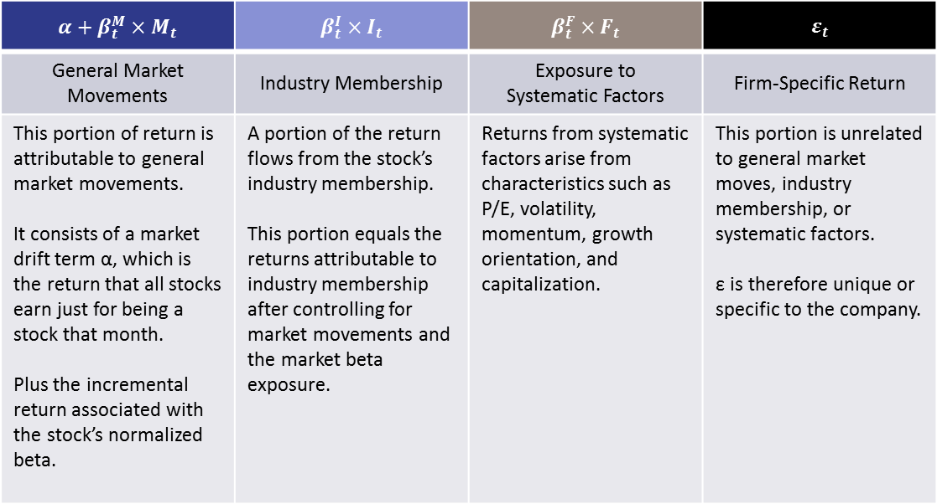
RISK CONTROL THROUGH EQUITY RISK MODELING
A dollar neutral Long/Short portfolio leaves the portfolio exposed to a potentially significant amount of risk to various factors including beta differentials, industry/sector exposures, value/growth exposure, and other systematic factors.
To utilize a more stringent level of risk control in portfolio construction, the long and short portions of the strategy are optimized to reduce risks by incorporating a risk modeling optimizer with the buy and sell lists. This ensures that the long and short positions are constructed with the same aggregate risk characteristics.
4 Components of Equity Returns
$$R_{t} = α+β_{t}^{M}×M_{t} + β_{t}^{I}×I_{t} + β_{t}^{F}×F_{t} + ε_{t}$$
$$α+β_{t}^{M}×M_{t}$$ | $$β_{t}^{I}×I_{t}$$ | $$β_{t}^{F}×F_{t}$$ | $$ε_{t}$$
General Market Movements | Industry Membership | Exposure to Systematic Factors | Firm-Specific Return
This portion of return is attributable to general market movements. It consists of a market drift term α, which is the return that all stocks earn just for being a stock that month. Plus the incremental return associated with the stock’s normalized beta. | A portion of the return flows from the stock’s industry membership. This portion equals the returns attributable to industry membership after controlling for market movements and the market beta exposure. | Returns from systematic factors arise from characteristics such as P/E, volatility, momentum, growth orientation, and capitalization. | This portion is unrelated to general market moves, industry membership, or systematic factors. ε is therefore unique or specific to the company.

Slide 11
CRE Modeling CRE Modeling framework: ETUDE
The hub of Cello’s Investment Process is the CRE Asset and Loan Modeling Framework – Etude
The framework provides a systematic way to track and forecast property- and loan-level metrics at a micro- and macro-level.
The outputs of this framework provide a foundation for the detailed credit work needed to address idiosyncratic issues.
Etude Components
Property, Loan and Securities Database
Property-level data
Loan-level data
CMBS Deals
Property and Loan-Level Reviews
Property conditions: Financials & Physical Inspections (where appropriate)
Qualitative underwriting review for large, delinquent, or special serviced loans
Quantitative vetting for all other loans
Model Assumptions
NOI and Cap rate forecasts
Default triggers (e.g. DSCR levels)
Extension parameters
Workout Periods/Costs
Other model parameters
Loan Cash Flow and Outcome Projections
Cash flow and outcome estimates for each loan
Outcomes include: Payoff/Term Default/Maturity Default/Extension
Scenario analysis
Property and Loan Trends
Establishing Themes
Gain insight into property- and loan-level trends that can be applied to both public and private holders of real estate
Develop scenario forecasts for the evolution of NOI, Cap Rates, Rents, and Vacancies
The Investment Process is not totally subordinate to history and incorporates market expectations into the decision-making process

Slide 12
reit VALUATION
The REIT valuation model relies on the CRE modeling framework to project NOIs and Cap Rates at a granular level corresponding to the real estate that the REIT holds.
Valuation metrics considered in the analysis include EBITDA, FFO, AFFO etc.
Direct Property |  | REIT
Potential Gross Income (PGI) | 180 | Potential Gross Income (PGI) | 180
Vacancy | -9 | Vacancy | -9
Operating Expenses | -71 | Operating Expenses | -71
NOI | 100 | NOI (property level) | 100
 |  | General and Administrative Expenses | -3
 |  | EBITDA | 97
Interest Expense | -40 | Interest Expense | -40
 |  | Funds from operations (FFO) | 57
Depreciation Expense | -20 | Depreciation Expense | -20
GAAP Net Income | 40 | GAAP Net Income | 37
 |  | (Dividends >= 0.9 x Net Income = 33.3)
Add back Depreciation | 20 | Add back Depreciation | 20
CapEx | -15 | CapEx | -15
Equity-before-tax cash flow (EBTCF) | 45 | Adjusted funds from operations (AFFO) | 42
Source: Blackrock, Cello

